Slide 1
Amazon Sheet Metal DFM Requirements
Part design recommendations for laser cutting, turret punch, and progressive die based on process capabilities Bruce Johnson 9-27-24
With Sanmina Comments : Jarrett Pivarunas 10/28/2024

Slide 2
Turret Press Process Capabilities
Description | Tolerance mm (inch)
FEATURE to FEATURE | +/-0.10 (0.004”)
PUNCHED feature size | +/-0.10 (0.004”)
FEATURE with multiple hits | +/-0.20 (0.008”)
FEATURE to EDGE | 1.33T (material thickness)
Sanmina Guadalajara meets these tolerances

Slide 3
Laser Cutting Press Process Capabilities
Description | Tolerance mm (inch)
FEATURE to FEATURE | +/-0.10 (0.004”)
FEATURE to EDGE | +/-0.10 (0.004”), 1.33T (material thickness)
Minimum KURF | +/-0.2 (0.008”)
Minimum FEATURE size | 0.25T, 25% material thickness
Sanmina Guadalajara meets these tolerances

Slide 4
Hand Brake Press Process Capabilities
Description | Tolerance mm (inch)
FOLD to FOLD | +/-0.5 (0.020”)
FOLD to FEATURE or EDGE | +/-0.4 (0.015”)
BEND angle | +/-1.5°
Minimum RADIUS | 1.33T (material thickness)
Sanmina Guadalajara meets these tolerances

Slide 5
Progressive Tool Process Capabilities
Sanmina Guadalajara meets these tolerances
Description | Tolerance mm (inch)
Distance between FEATURES in the same station | +/-0.05 (0.002”)
Distance between FEATURES in different stations | +/-0.2 (0.008”)
Distance between FOLDS in the same station | +/-0.2 (0.008”)
Distance between FOLDS in different stations | +/-0.4 (0.016”), [+/-0.3 (0.012”)]
FOLD to FEATURE or EDGE | +/-0.25 (0.010”), [+/-0.1 (0.004”)]
Bend ANGLE | +/- 1°
Minimum HOLE diameter, SLOT width | 1.33T (material thickness)
HOLE or FEATURE size | +/-0.08 (0.003”), [+/-0.03 (0.001”)]
Flatness | 0.15/100mm, (0.006”/4”)
Straightness | 0.12/100mm, (0.005”/4”)
[Fine tolerances achievable at additional cost]

Slide 6
General Design Guidelines Checklist
Specify punch direction
Specify grain direction
Specify areas that need deburring or coining
Identify features that need to be grouped in a single station for best tolerancing
Avoid secondary operations if possible
Keep embosses and draws shallow
Use standard readily available materials
Use precoated materials, avoid unplated materials or secondary protective films
Review design for handling and shipping damage
Review strip layout before releasing hard tooling to the supplier
Communicate features that are not stable during tooling so mitigation can be put in place
Sanmina Guadalajara meets these Guidelines, part of general/standard practices

Slide 7
General Design Guidelines Checklist (cont.)
Add tooling hole(s) to supply consistent reference features if possible
Specify acceptable locations for carrier tabs
Datum structure(s) aligns with the use and function of the part
GD&T clearly defines features
Ensure that process control dimensions can be measured at the press with simple tools
Use sheared edges for all critical reference features
Define maximum and minimum bend radius
Design inspection fixtures and process in parallel with the part design
Clearly specify critical and major dimensions
Sanmina Guadalajara meets these Guidelines, part of general/standard practices

Slide 8
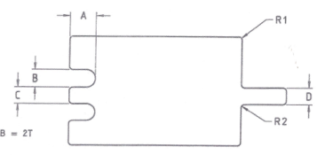
Design Guidelines
A max = 2B or 6T
B min = 1.33T
C min = 2T
D min = C
R1 min = 0.5T or 0.4
R2 min = 0.5T or 0.4
Sanmina Guadalajara meets these guidelines

Slide 9
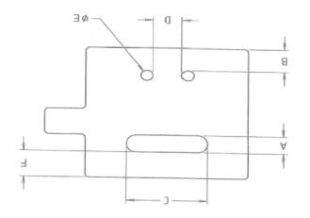
Design Guidelines
A min = 2.0T
B min = 2.0T
C max = 50mm when A = minimum
C min = 2R + T
D min = 2T
E min = 1.2T
F min = 3T if C <= 10T 4T if C > 10T
Sanmina Guadalajara meets these guidelines

Slide 10
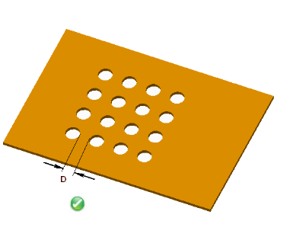
Design Guidelines
Minimum distance between holes D = 1.2T
Sanmina Guadalajara meets these guidelines

Slide 11
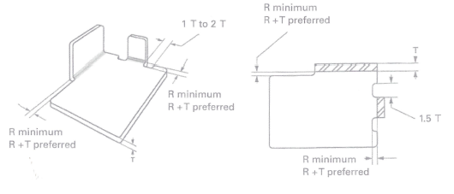
Bend Relief
Sanmina Guadalajara meets these guidelines

Slide 12
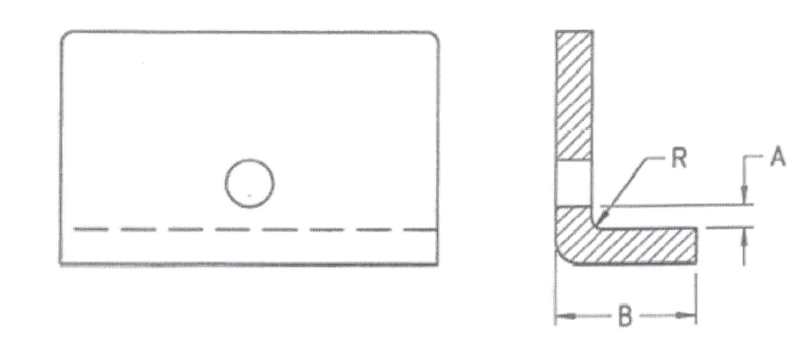
Hole Distance from Bend
A min = 2.0T + R
B min = 3T + R
R min = 1.0T or 0.6 mm minimum
Sanmina Guadalajara meets these guidelines

Slide 13
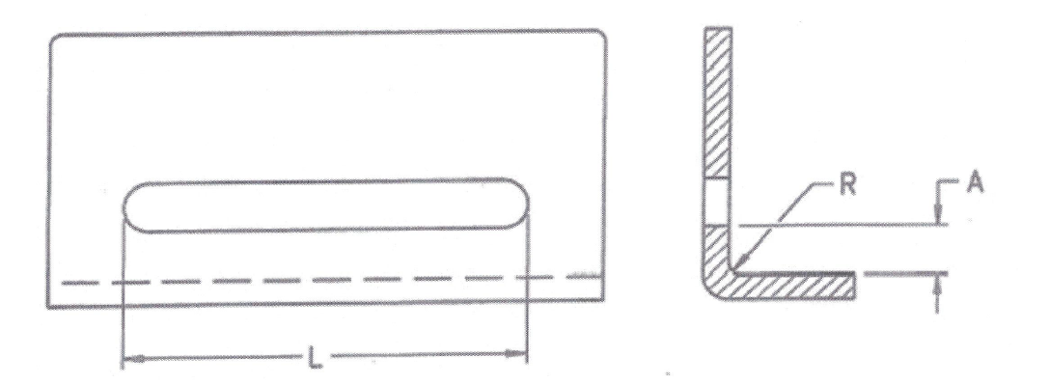
Bend Radius
R min = 1.0T or 0.6 mm minimum
When required (only when using low carbon steel R min = 0.5T
Sanmina Guadalajara meets these guidelines

Slide 14

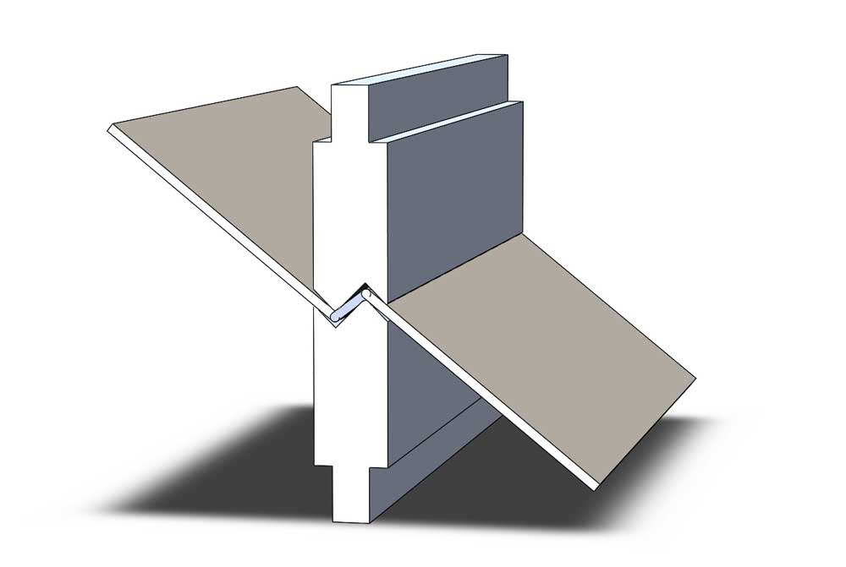
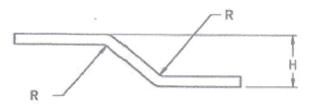
Z Bends
90° Offset
H <= 5T
R = 1.5T
45° Offset
R = 0.2mm
Sanmina Guadalajara meets these guidelines

Slide 15
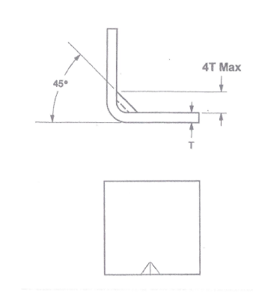
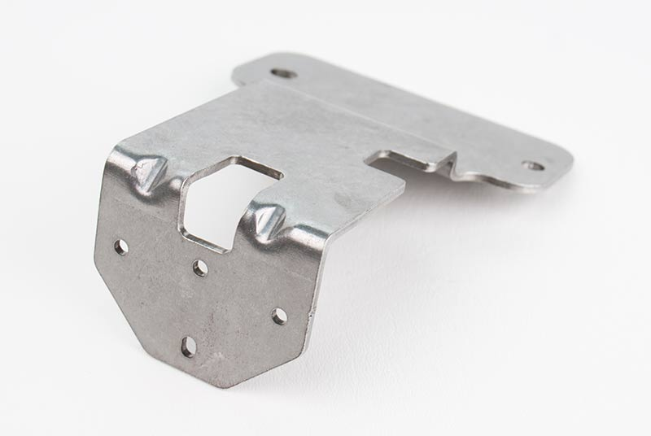
Stamped Gussets
Sanmina Guadalajara meets these guidelines

Slide 16

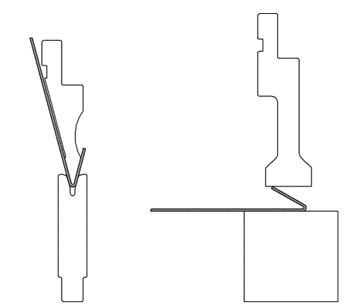
Hems
Used to hide burrs, not improve flatness
Operation requires multiple steps
Tear drop is most common
Minimum return flange height = 4T
Minimum distance from hole = 2T
Minimum distance from internal bend = 5T
Minimum distance from external bend = 8T
Flat hems tend to fracture and cause entrapment of fluids
Step 1, Acute angle bend
Step 2, flattening bar
Sanmina Guadalajara meets these guidelines in the soft tool process

Slide 17
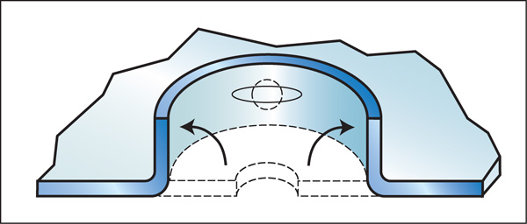
Extrusions
Minimum distance between extrusions = 6T
Minimum distance extruded hole to edge = 3T + 2R
Minimum distance extruded hole to a bend = 3T + R
Minimum extrusion height H should allow 4 threads of engagement (~80% strength achieved with 4 threads)
H = 2.0T – 2.5T for a M3 screw
H = 2.5T – 3.0T for a M4 screw
Sanmina Guadalajara meets these guidelines

Slide 18

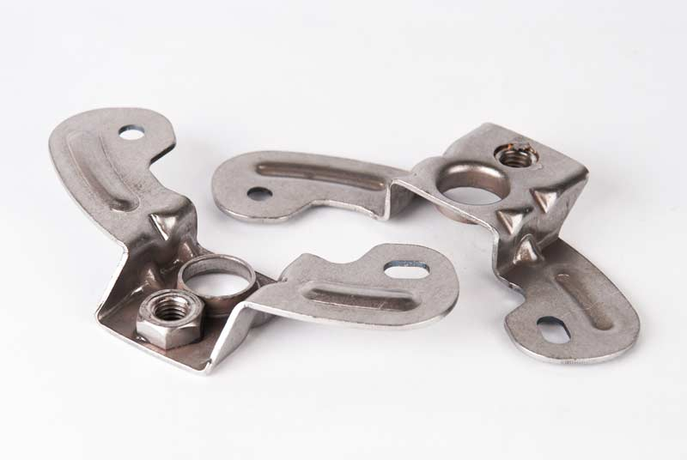
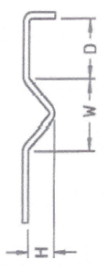
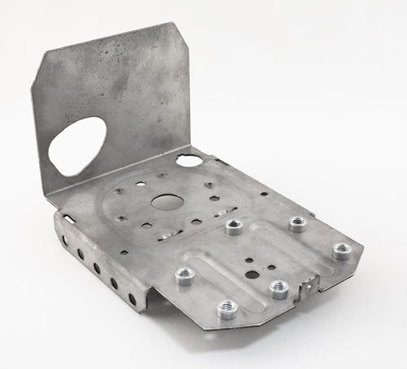
Embossments / Stiffing Rib
Round
Maximum height H = 3T
Minimum width W = 3T
V embossment
Maximum height H = 3T
Minimum width W = 3H
Flat
The maximum depth = internal radius plus the external radius
Minimum distance between parallel embossments = 10T
Minimum distance to edge = 4T
Minimum distance to Hole = 3T
Minimum distance to Fold D = 4T
Round
Flat
Sanmina Guadalajara meets these guidelines

Slide 19
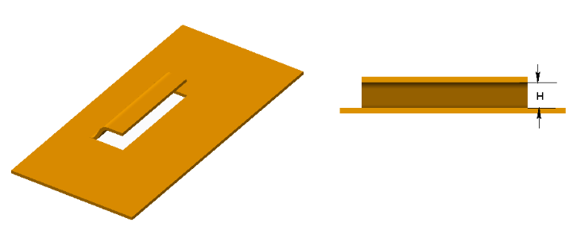


Lance and Form
Minimum height H = 2T
Minimum distance between lance and fold = 3T + R (R = inside bend radius)
Minimum distance between lance and Hole = 3T
Minimum web distance between lances = 6T
No bend relief required
Sanmina Guadalajara meets these guidelines

